Slide 1

.
Student Result Management System
SUBMITTED TO:
SIR ADEEL
GROUP MEMBERS:
MAIMOONA BIBI(055)
MALAYKA IBRAR (058)
NATASHA MARYAM(068)

Slide 2

Introduction: A Student Result Management System (SRMS) is a software application designed to manage and maintain the results of students in an educational institution. Using Java Swing for the user interface, we can create a desktop application that is both user-friendly and efficient.

Slide 3
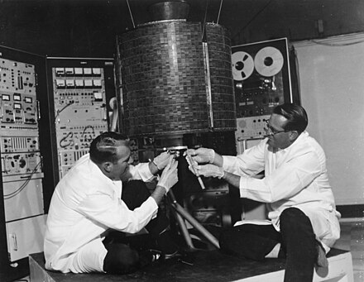
KEY COMPONENTS:
User Interface (UI)
JFrame; The main window of the application.
Jpanel; A container that can hold a group of components.
Jlabel; Displays text or images.
JTextField; A text input field.
Jbutton; A button that triggers actions when clicked.
Jtable; Displays data in a tabular format.
Database Integration
Java Database Connectivity (JDBC), that is used to interact with the database
3.Event Handling
Handling actions such as button clicks

Slide 4
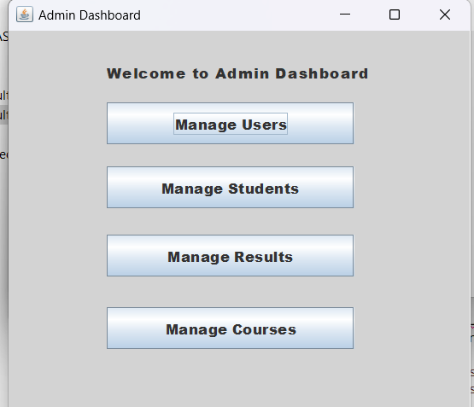
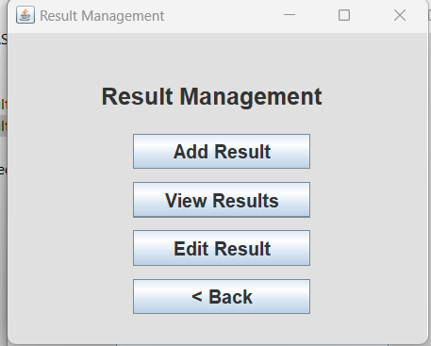
FUNCTIONAL FEATURES:
Add Results: Enables users to add new student result records.
View Results: Displays student results in a tabular format.
Update and Delete: Potential features to update or delete records.

Slide 5

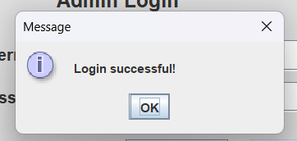
DATA MANAGEMENT:
Data Validation:
Ensures the correctness of data entered.
Error Handling:
Provides error messages in case of issues.

Slide 6

USABILITY AND ACCESIBILITY:
User Feedback:
Informative messages upon successful data insertion or updates.
Responsive Design:
Accommodating additional features like search functionality or report generation.

Slide 7

STRUCTURE OF SRMS:
Main Frame (JFrame):
Primary window of the application
Contains navigation elements
Forms (JPanel, JTextField, JButton):
Used for data entry and interaction
Forms for adding new student results
Result Viewing:
Displays student results in a tabular format
Uses JScrollPane for large records

Slide 8

Example Code Snippet
import java.sql.Connection;
import java.sql.DriverManager;
import java.sql.SQLException;
public class OracleDatabaseConnection {
private static final String URL = "jdbc:oracle:thin:@localhost:1521:xe";
private static final String USER = "username";
private static final String PASSWORD = "password";
public static void main(String[] args) {
Connection connection = null;
try {
Class.forName("oracle.jdbc.OracleDriver");
connection = DriverManager.getConnection(URL, USER, PASSWORD);
if (connection != null) {
System.out.println("Connected to Oracle database!");
}
} catch (ClassNotFoundException e) {
System.out.println("Oracle JDBC driver not found.");
e.printStackTrace();
} catch (SQLException e) {
System.out.println("Connection failed.");
e.printStackTrace();
} finally {
try {
if (connection != null) {
connection.close();
System.out.println("Connection closed.");
}
} catch (SQLException e) {
e.printStackTrace();
}}}}

Slide 9
CONCLUSION
In conclusion, the field of artificial intelligence (AI) is marked by remarkable advancements and transformative potential, bringing about numerous benefits and opportunities. However, like any powerful technology, AI also poses challenges and concerns that warrant careful consideration and responsible management.
The pros of AI include increased efficiency through automation, enhanced productivity, data analysis capabilities, precision, and innovation across various sectors. AI has the potential to revolutionize industries such as healthcare, finance, and transportation, offering solutions to complex problems and contributing to scientific and technological progress.
This document provides an overview of developing a Student Result Management System using Java Swing. The system includes a main frame for navigation, forms for adding results, and tables for viewing results. JDBC is used for database interaction, and event handling is implemented to manage user actions. This framework can be extended with additional features like updating and deleting records, advanced search, and report generation.

Slide 10
REFERENCES:
Django LMS (Learning Management System)
SRMS in Java (OOP)
Student Management System in Java (OOP)
C++ Student Management System (OOP)

Slide 11
THANK YOU

